Slide 1
Promotion to associate professor with tenure Workshop
February 20, 2024

Slide 2
AGENDA
P&T perceptions and outcomes
P&T processes and practices
Faculty Affairs’ Advice & Recommendations
Perspectives
Department heads’
Dean’s
University P&T committee’s
Recently promoted faculty
Questions and discussion

Slide 3
P&T Perceptions AND Outcomes
Ron fricker, vice provost for faculty affairs

Slide 4
CLARITY OF TENURE PROCESS
FROM 2023 COACHE FACULTY JOB SATISFACTION SURVEY

Slide 5
CLARITY OF TENURE STANDARDS
FROM 2023 COACHE FACULTY JOB SATISFACTION SURVEY

Slide 6
PROMOTION AND TENURE SUCCESS 2013-2023

Slide 7
P&T PROCESSES AND PRACTICES
Ron fricker, vice provost for faculty affairs

Slide 8
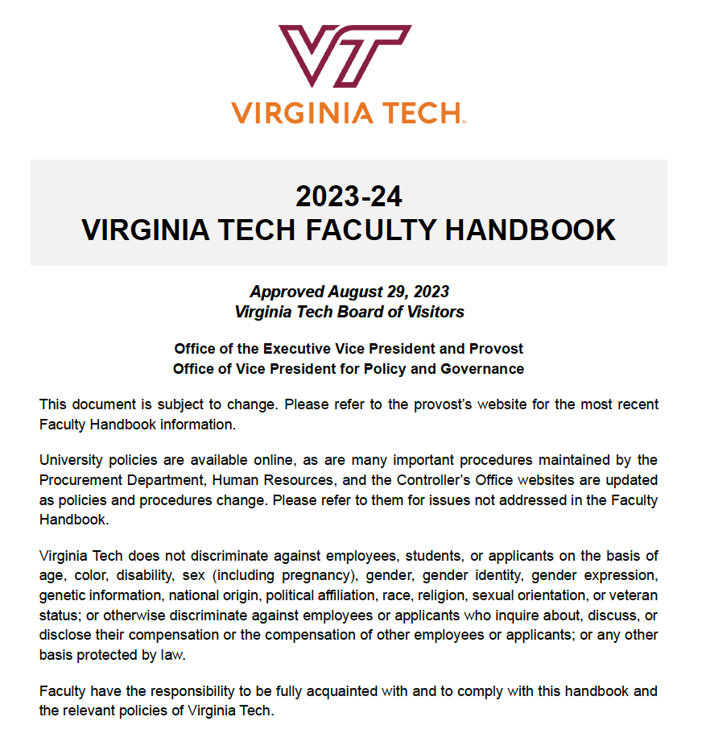
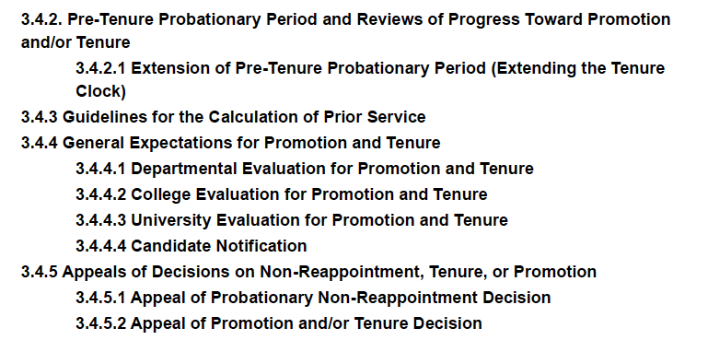
P&T Governed by Faculty Handbook
Section 3.4 in particular:
See https://faculty.vt.edu/faculty-handbook.html

Slide 9
Important Info on Provost’s Website
Dossier template and preparation guidelines
University-level deadlines for promotion and tenure review
P&T Workshop dates
Historical summary of P&T outcomes
See https://faculty.vt.edu/promotion-tenure.html

Slide 10
PROMOTION AND TENURE PROCESS
Department Level
College Level
University Level
Dossier
P&T Comm
Head
P&T Comm
Dean
P&T Comm
Provost
External Letters
BOV
President

Slide 11
PROMOTION AND TENURE DOSSIER OUTLINE
I. Executive Summary
II. Recommendation Statements
III. Candidate’s Statement
IV. Teaching and Advising Effectiveness
V. Research and Creative Activities
VI. International & Professional Service and Other Outreach & Extension Activities
VII. University Service
VIII. Work Under Review or In Progress
IX. Other Pertinent Activities
See https://faculty.vt.edu/promotion-tenure.html

Slide 12
P&T POLICIES AND PRACTICES
POLICIES
2nd and 4th year progress reviews
Tenure clock extension(s)
Modified duties
Non-mandatory promotion to associate with tenure
See memo dated September 21, 2022
PRACTICES
Mentoring
P&T Workshops
P&T Committee and Heads
Promotion to Professor
College-based workshops
Written expectations and standards

Slide 13
Some Advice & recommendations
Ron fricker, vice provost for faculty affairs

Slide 14
SOME RECOMMENDATIONS
Follow the dossier guidelines carefully and scrupulously
Don’t take someone’s from a previous year and modify it
Don’t be creative with the template...just follow the format
Do ask colleagues, mentors, and dept leaders to review it and make recommendations and editing suggestions
Do make sure everything adds up and is consistent
Work and rework your candidate statement
Can only be four pages in length (double spaced)
Your opportunity to put your work in context and to emphasize impact:
Start with an introductory statement about your professional identity
Explain the character, coherence, direction, and purpose of your scholarly and professional work
Put it in the context of the broad field(s) in which you are working

Slide 15
SOME RECOMMENDATIONS (CONTINUED)
Statement should enable members of the university promotion and tenure committee to understand clearly your professional aims and achievements
Need to put it in terms everyone can understand (i.e., do not use specialized jargon)
Get colleagues outside of your field to read it; if they can’t understand what you do and why it’s important, revise, revise, revise
External reviewers
“External reviewers are expected to be professors at major research universities; these reviewers should be viewed as senior contributors to the appropriate related discipline(s) or area of scholarship.”
“Reviewers should not be former advisors, postdoctoral supervisors, co-investigators on grants, or coauthors on recent publications, or should not have other relationships that may be perceived as being too close to the candidate. When possible, avoid selecting external reviewers from the candidate’s Ph.D. granting institution or from universities at which the faculty member had a prior faculty position.”

Slide 16
SOME RECOMMENDATIONS (CONTINUED)
You get to recommend some external reviewers; your department picks from your list and others they choose independently (at least three)
Be strategic about your recommendations
Do not recommend colleagues who do not meet the previous criteria
What does “coauthors on recent publications” mean?
You should not contact your reviewers or others who may have been asked
Can’t modify your dossier once officially submitted
Achievements after can be included in dept head’s, dean’s letter, and can even be presented verbally to the University P&T Committee
My best advice: Solicit input and advice from many and varied colleagues and mentors early and often...and listen to that advice

Slide 17
KEY RESOURCES
Colleagues
Professors in your department/school
Department head, chair, or school director
Members of the departmental P&T committee
Mentors and other professional colleagues
References
Faculty Handbook, chapter 3
Provost’s website
Promotion and Tenure Guidelines
Dossier Template and Cover Page
College and/or departmental expectations and procedural documents

Slide 18
P&T PERSPECTIVES
Department Head
Dean
University P&T Committee
Views from Recently promoted faculty

Slide 19
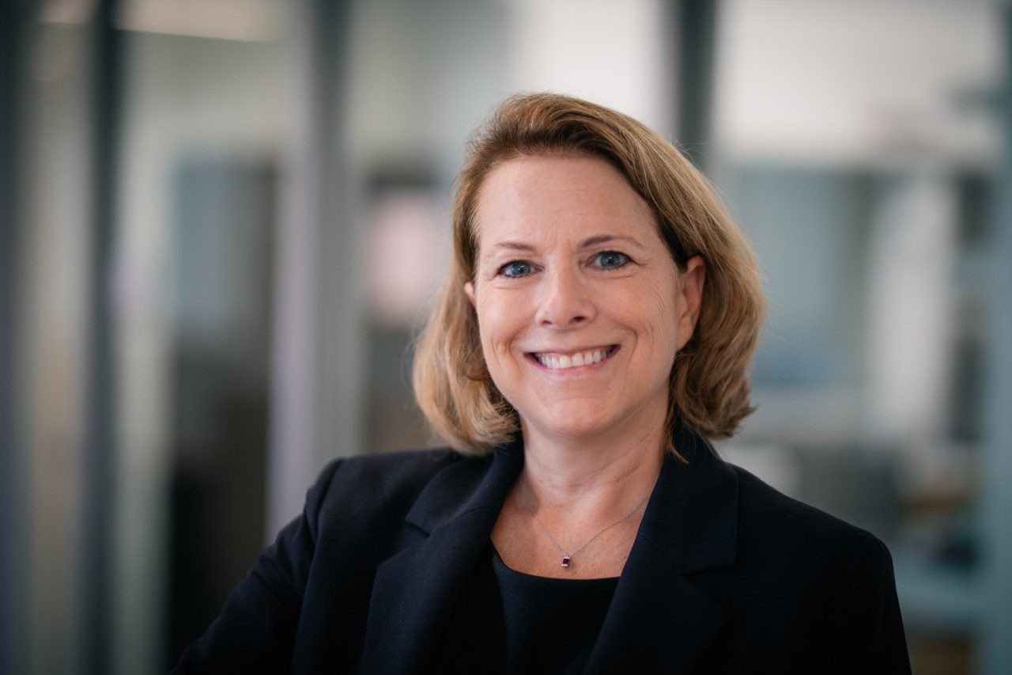
Department head’s PERSPECTIVE
Eileen Van Aken
Industrial and Systems Engineering

Slide 20
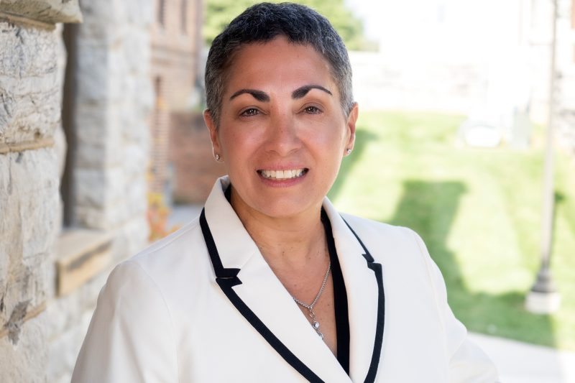
Dean’s PERSPECTIVE
Laura Belmonte
College of Liberal Arts and Human Sciences

Slide 21
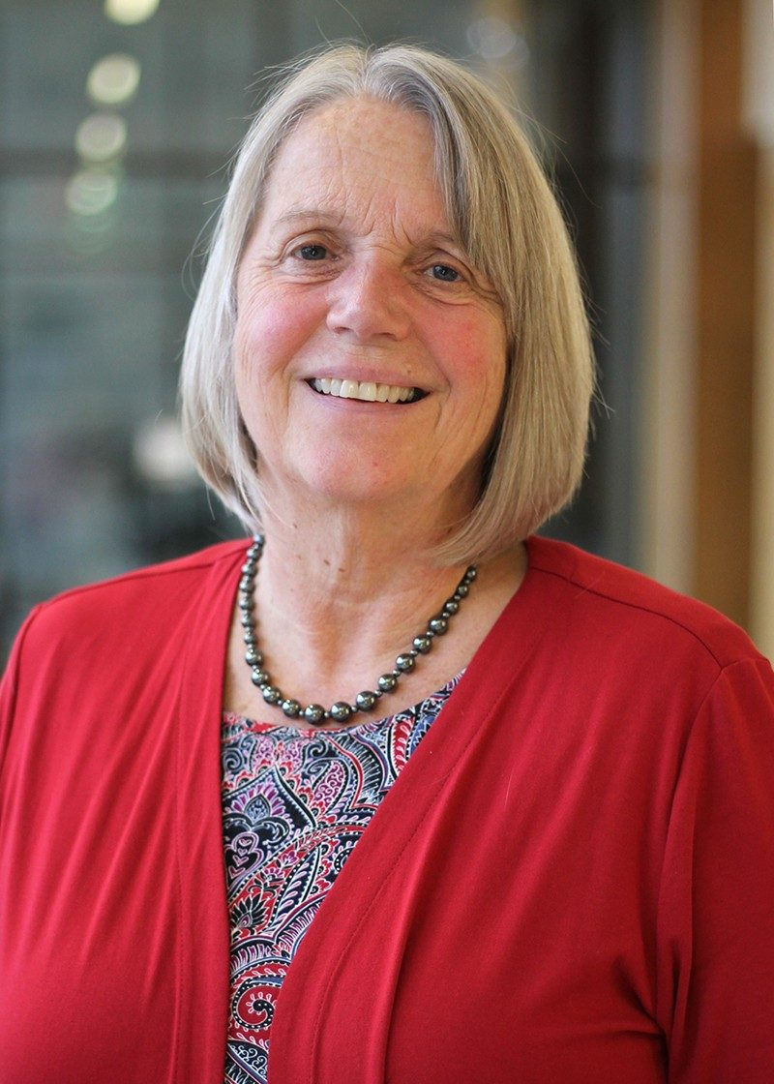
University committee PERSPECTIVE
Virginia Buechner-Maxwell
Professor, Department of Large Animal Clinical Sciences

Slide 22
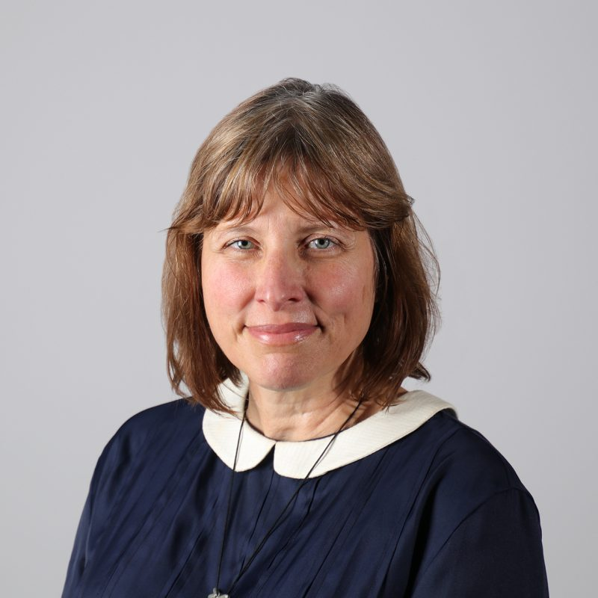
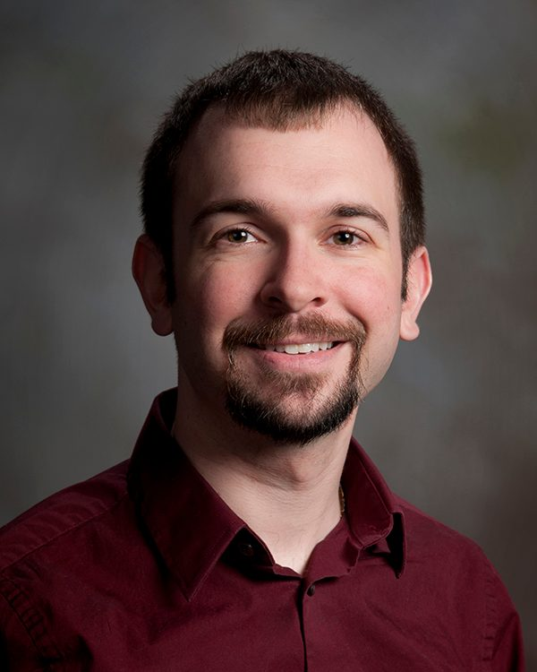
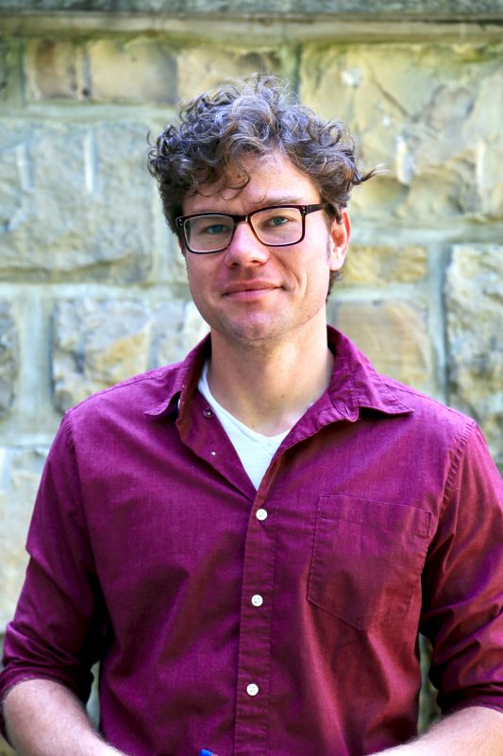
PERSPECTIVEs from recently promoted faculty
Meredith Drum
Associate Professor
School of Visual Arts
Justin Lemkul
Associate Professor
Department of Biochemistry
Frank Aylward
Associate Professor
Department of Biological Sciences

Slide 23
Questions and discussion
Visit the Promotion and Tenure website for more information:
https://faculty.vt.edu/promotion-tenure.html

Slide 24
OTHER RESOURCES

Slide 25
COVID-19 IMPACT CONSIDERATIONS
Faculty COVID statements
Inclusion of cancelled/postponed and/or virtual presentations
SPOT scores for calendar year 2020 optional
Tenure Clock Extensions
Work assignment adjustments
Modified duties
External letter reuse
See https://faculty.vt.edu/promotion-tenure/adaptations-promotion-tenure-process.html

Slide 26
COLLEGE P&T GUIDELINES
College of Agriculture and Life Sciences
College of Architecture, Arts, and Design
College of Engineering
College of Liberal Arts and Human Sciences
College of Natural Resources and the Environment
College of Science
Pamplin College of Business
Virginia-Maryland College of Veterinary Medicine
Virginia Tech Carilion School of Medicine

